Slide 1
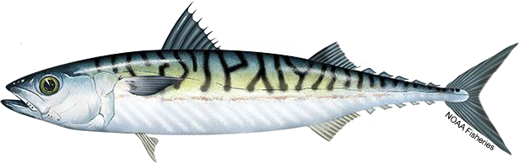

ToR 5: Atlantic mackerel
Kiersten Curti & Alex Hansell
State-space Research Track Peer Review
Working paper 10
2/09/24

Slide 2
Assessment Timeline
Last benchmark 2017
Last management track 2023
State-space research track 2024
Next management track 2025
2

Slide 3
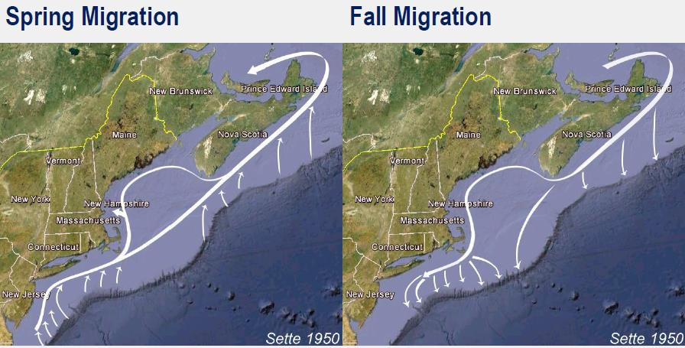
Background
Two spawning contingents that migrate seasonally and mix on the NE US Shelf during winter months
Previous assessments have struggled with poor diagnostics
Currently accepted ASAP model exhibits a poor fit to the NEFSC trawl survey Albatross index, retrospective patterning, and poor projection performance
During the most recent (2023) management track assessment, the review panel recommended development of a state-space model to better deal with process error
and changing ecosystems
3

Slide 4
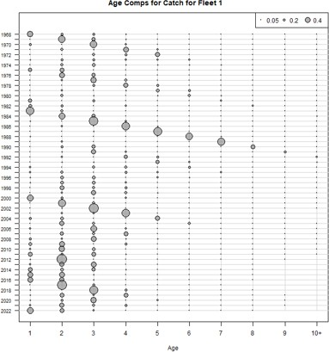
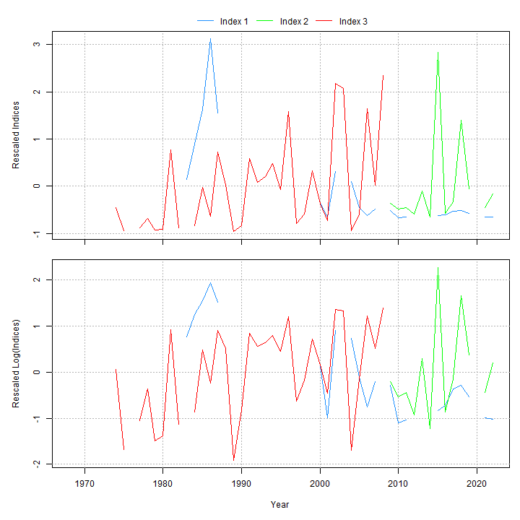
Data inputs
400
US.Commercial US.Recreational US.Comm.discards Canada Other.Countries
Catch (thousands mt)
300
Age Structured Assessment Program (ASAP)
200
100
0
1960 1970 1980 1990 2000 2010 2020
Year
Ages 1-10+
Fishery catch (1968-2022, one fleet)
Surveys:
Egg survey (1983-2022)
NEFSC spring (Albatross 1974-2008; ages 3+)
NEFSC spring (Bigelow 2009-2022 ; ages 3+)
Natural mortality = 0.2
4

Slide 5
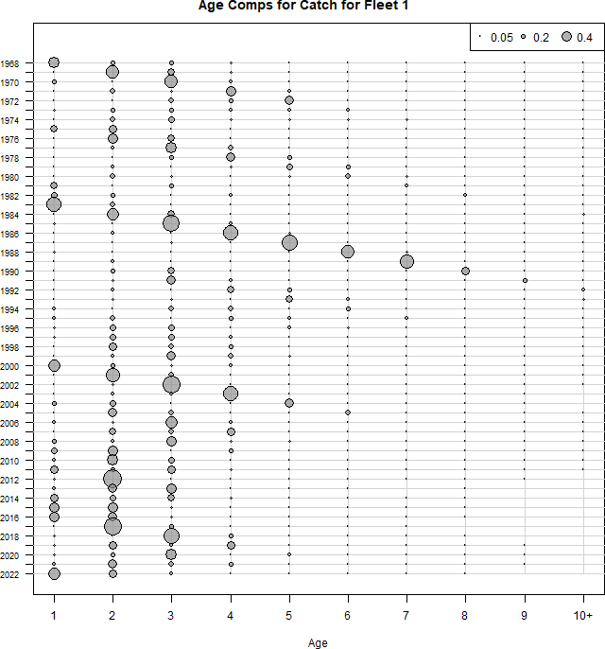

Fishery catch
400
US.Commercial US.Recreational US.Comm.discards Canada Other.Countries
Catch (thousands mt)
300
200
100
0
1960 1970 1980 1990 2000 2010 2020
Year
Figure 1 WP 10
5

Slide 6
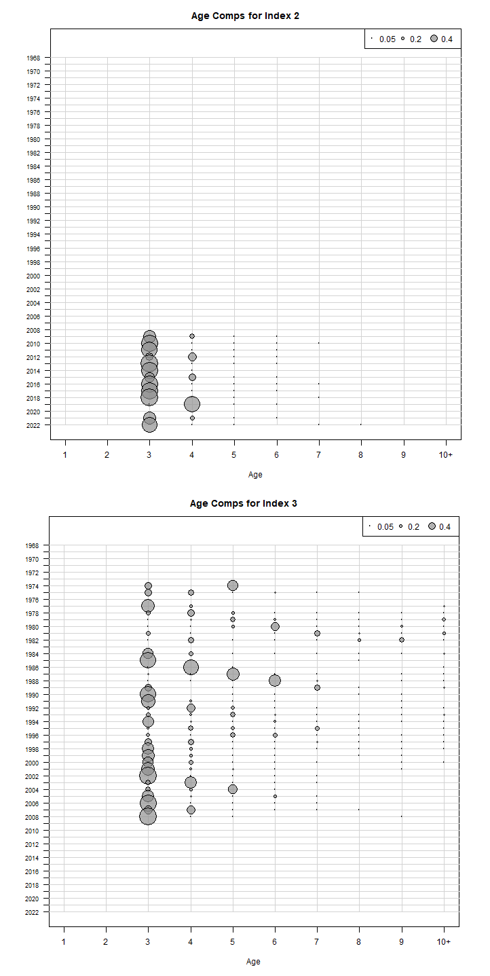
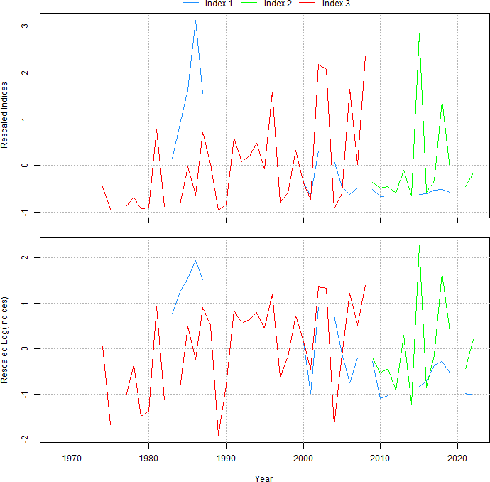
Survey indices
Index 1 = Egg index (blue) Index 2 = Bigelow (green) Index 3 = Albatross (red)
Figure 2 WP 10
Figure 3 WP 10
6

Slide 7
Survey indices
NEFSC trawl survey: Bigelow
Combined egg index
NEFSC trawl survey: Albatross

Slide 8

The plan
ASAP → WHAM
Age-comps
Recruitment
Time varying
Selectivity
NAA

Slide 9
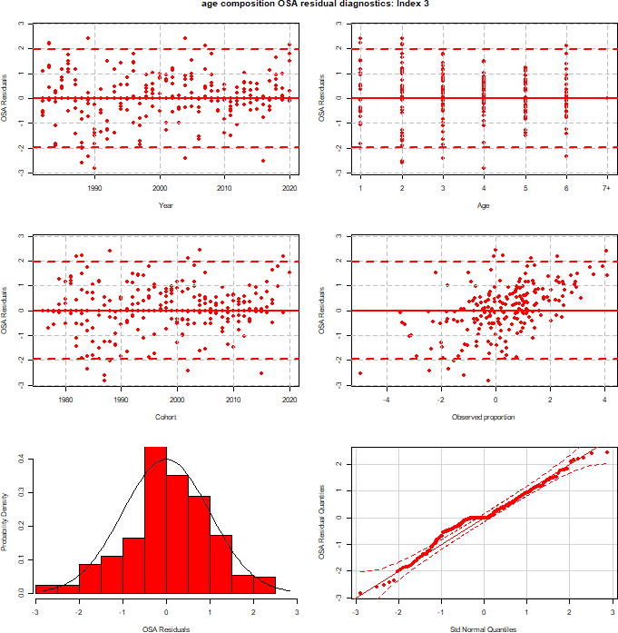
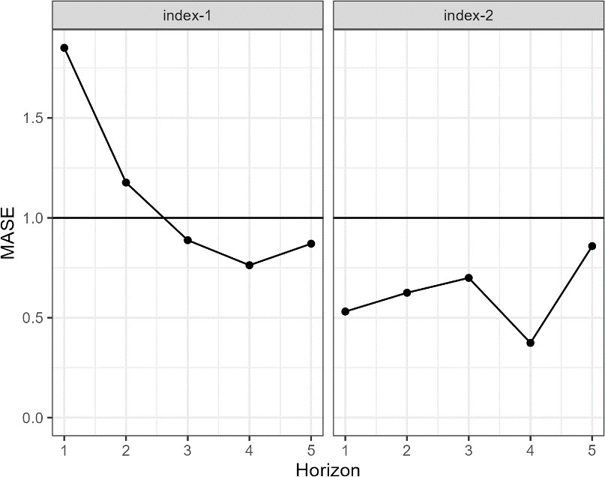
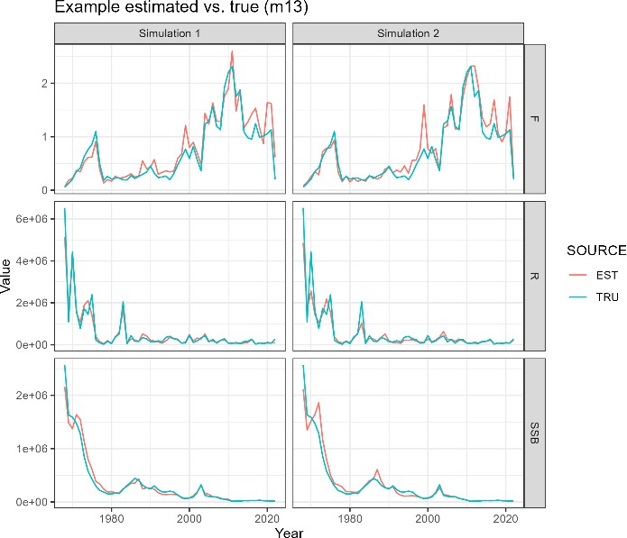
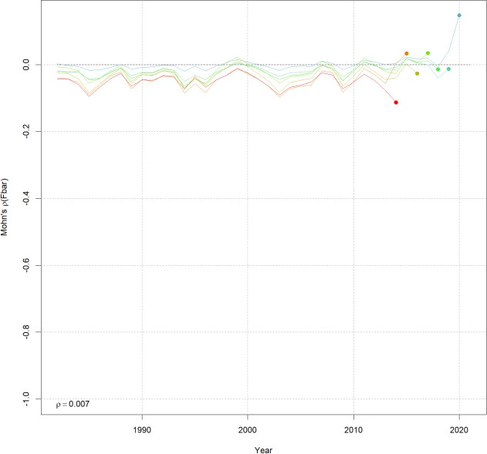
Diagnostics
Convergence
Residuals
AIC
Retrospective patterns
Prediction skill
Estimation performance
Plausibility

Slide 10
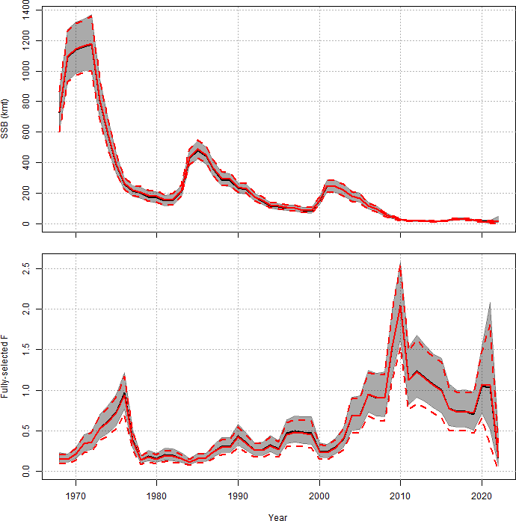
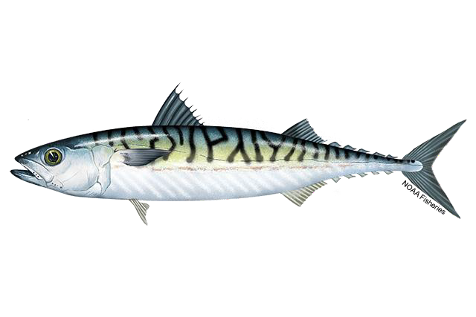
ASAP to WHAM
ASAP
WHAM
Figure 4 WP 10

Slide 11
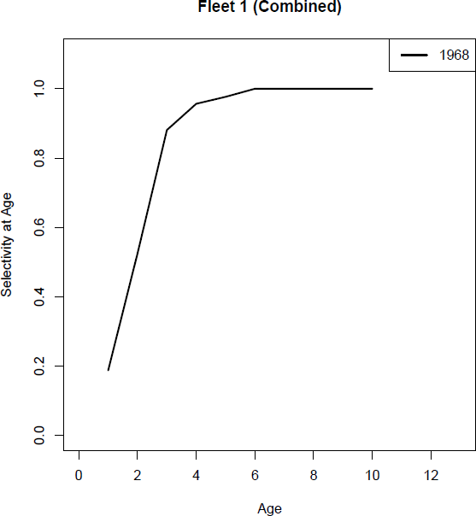
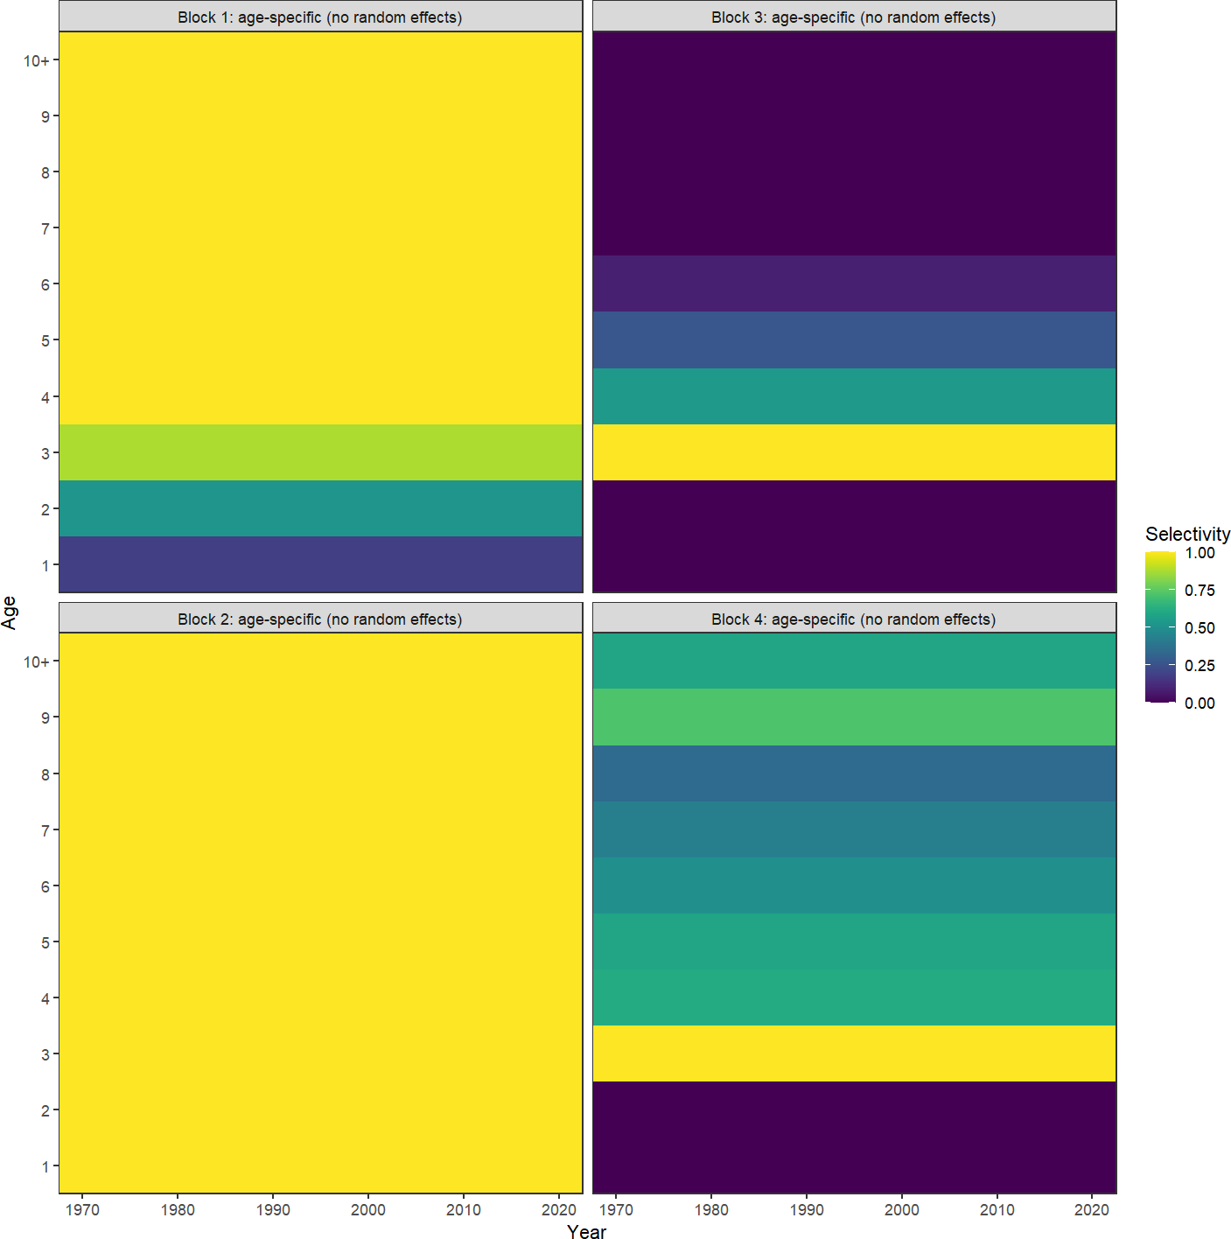
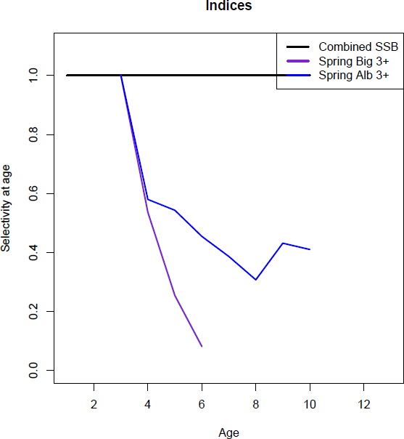
Selectivity
Block 1 = Catch Block 2 = Egg index Block 3 = Bigelow Block 4 = Albatross
Figure 6 WP 10
Figure 5 WP 10

Slide 12

The plan
ASAP → WHAM
Age-comps
Recruitment
Time varying
Selectivity
NAA

Slide 13
Age composition comparison
age_comp | converged | hessian | NLL | rho_R | rho_SSB | rho_Fbar
multinomial | Yes | No | 2305.805 | 0.1608 | 0.3633 | -0.228
dir-mult | Yes | Yes | 1769.636 | 0.5752 | 0.8363 | -0.4225
dirichlet-miss0 | Yes | Yes | -1488.64 | 0.9747 | 1.1804 | -0.4947
dirichlet-pool0 | Yes | Yes | -1481.17 | 0.9476 | 1.1474 | -0.4894
logistic-normal-miss0 | Yes | Yes | -1344.85 | 0.7369 | 0.7068 | -0.2969
logistic-normal-ar1-miss0 | Yes | Yes | -1578.05 | 0.8776 | 0.8802 | -0.4192
logistic-normal-pool0 | Yes | Yes | -1319.17 | 0.6501 | 0.6585 | -0.2722
mvtweedie | Yes | Yes | -1319.17 | 0.1809 | 0.5006 | -0.2307
Table 1 WP 10
12

Slide 14
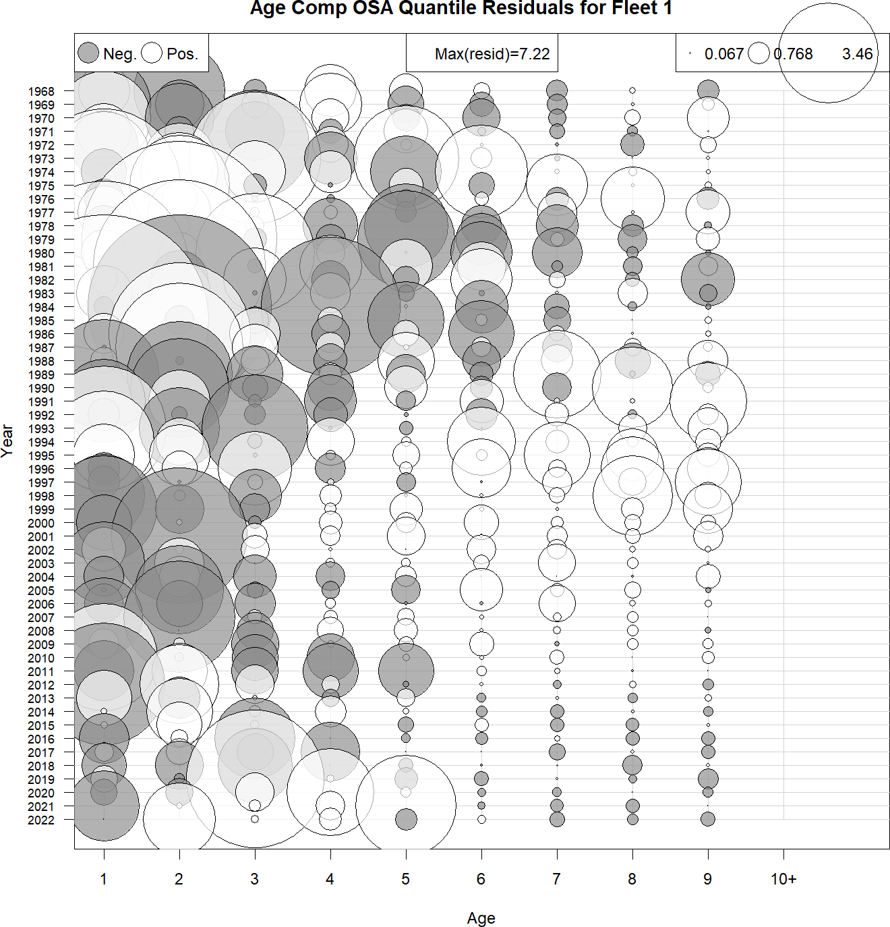
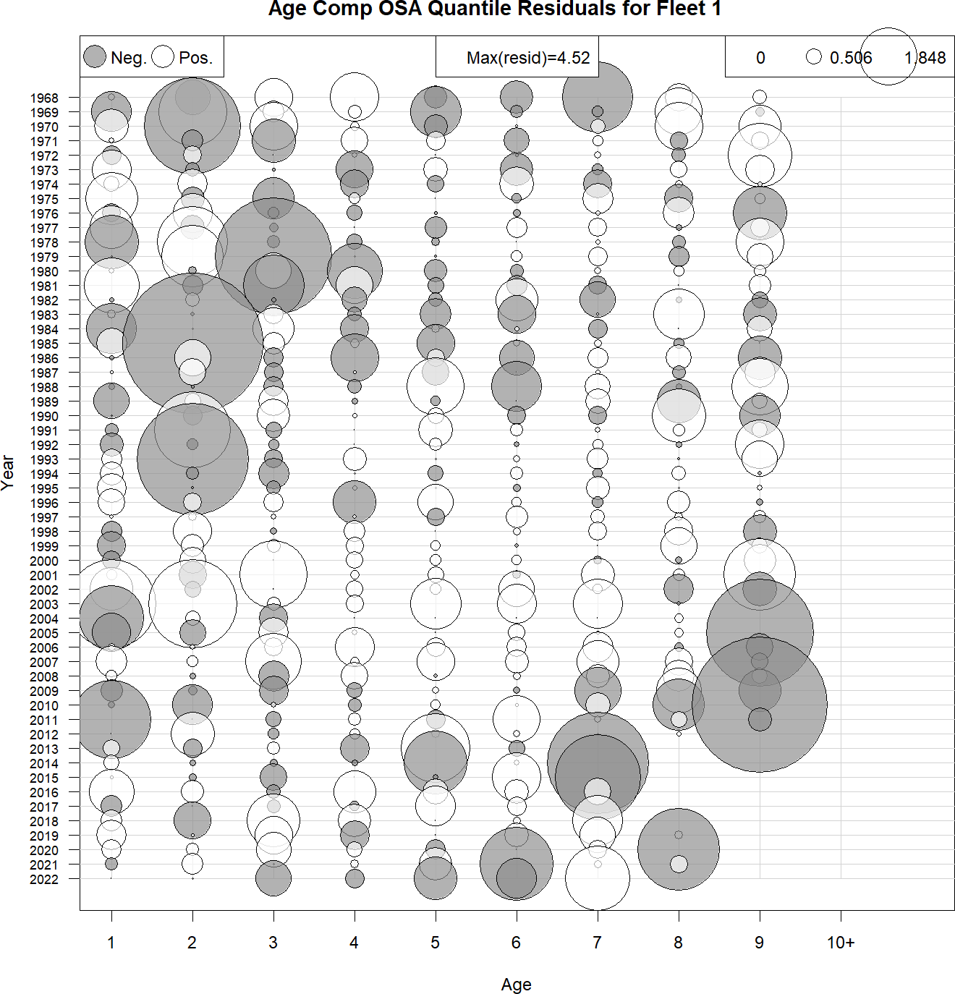
Fishery catch OSA residuals
GitHub Run1 & Run2
Multinomial
Logistic-normal-ar1-miss0

Slide 15
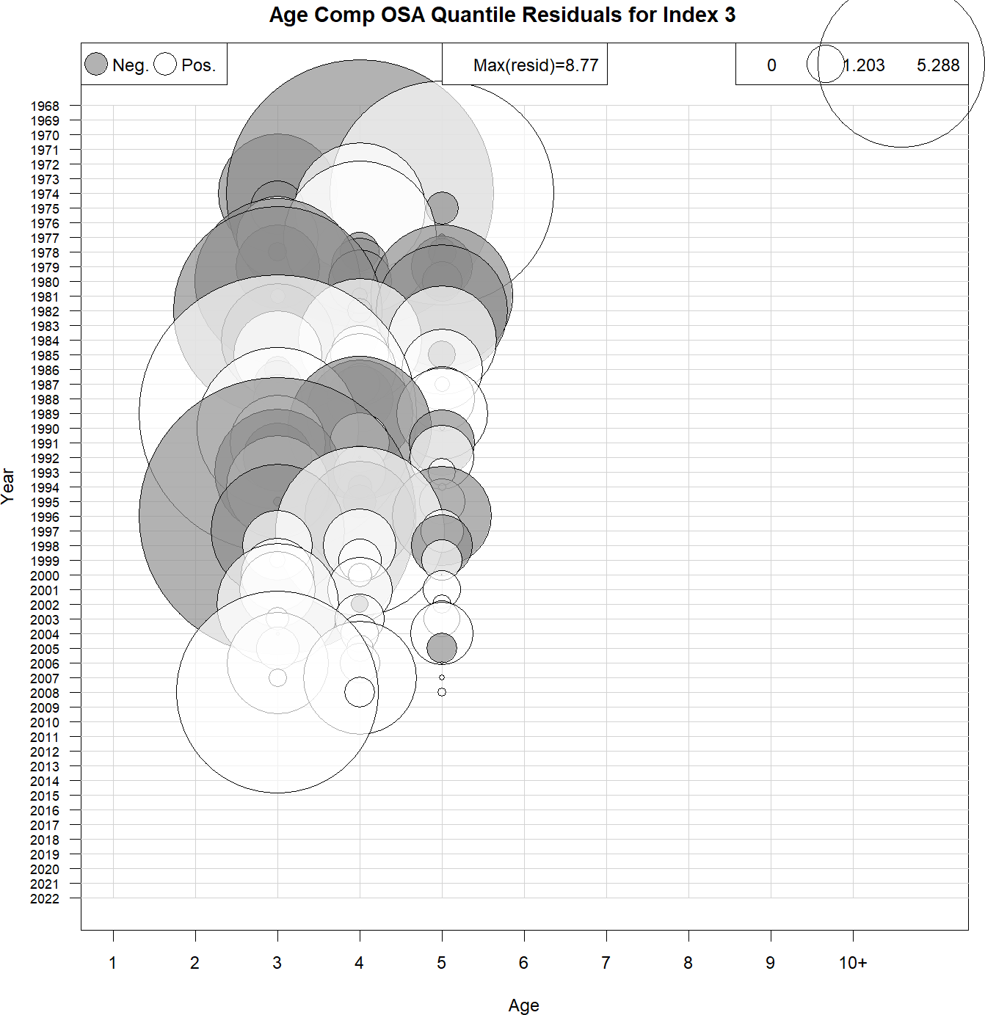
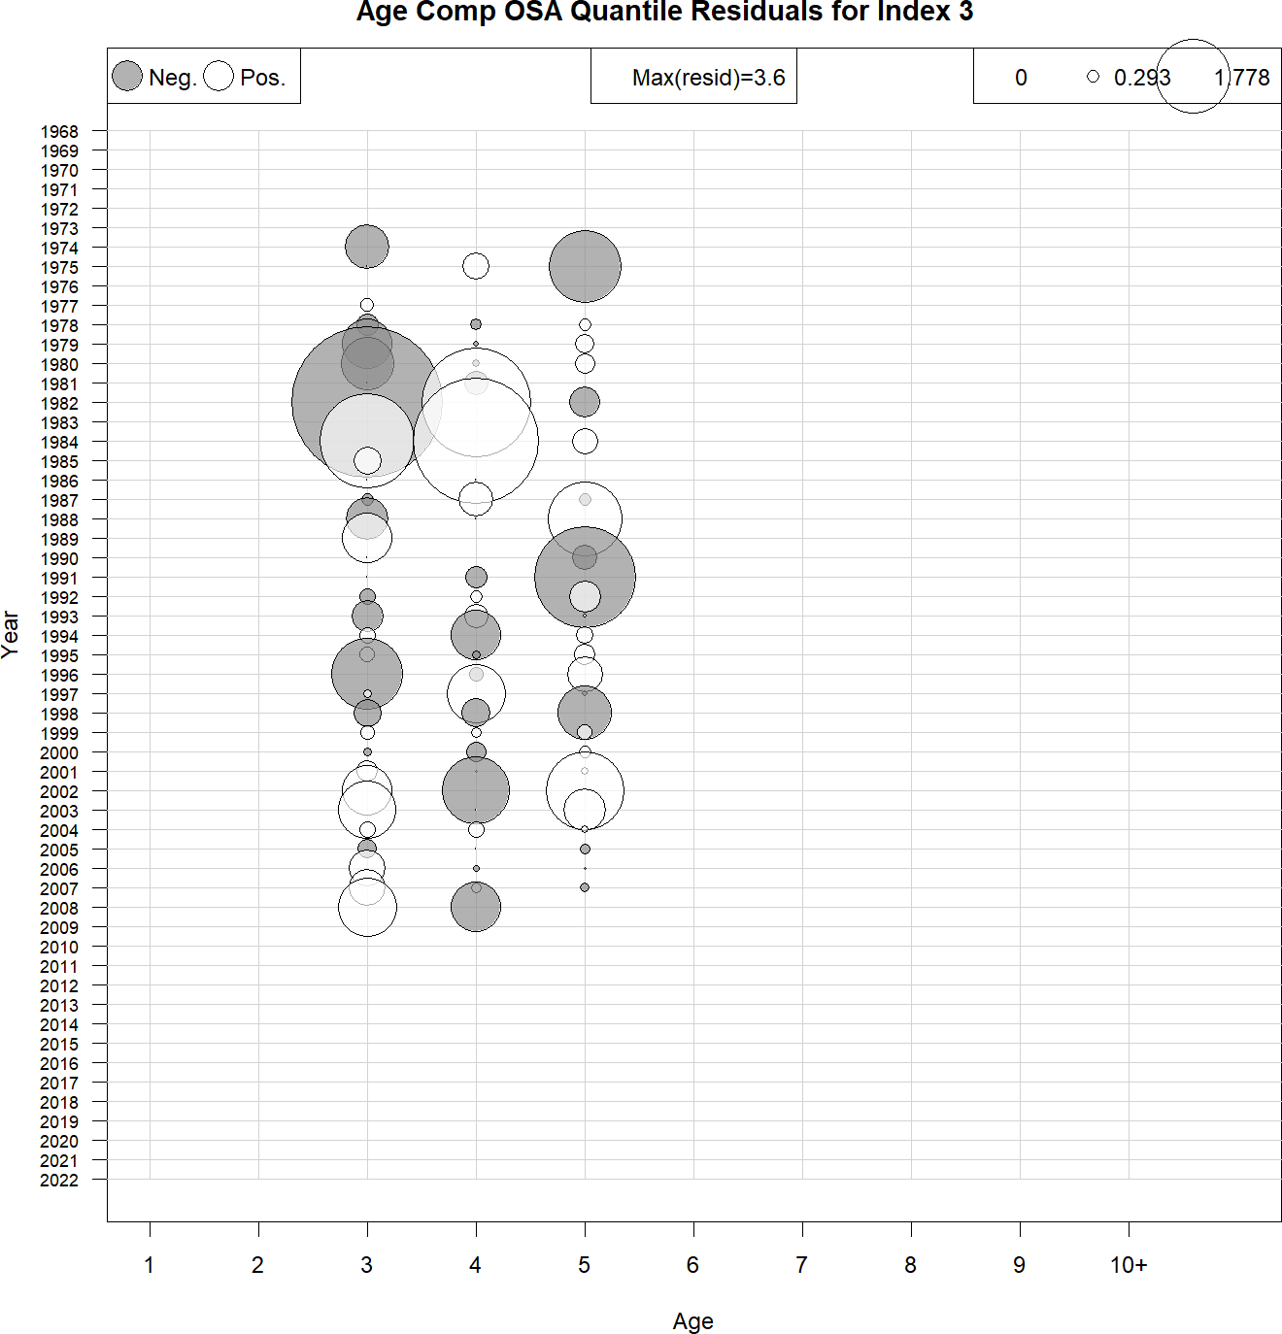
NEFSC Albatross OSA residuals
Multinomial
Logistic-normal-ar1-miss0

Slide 16
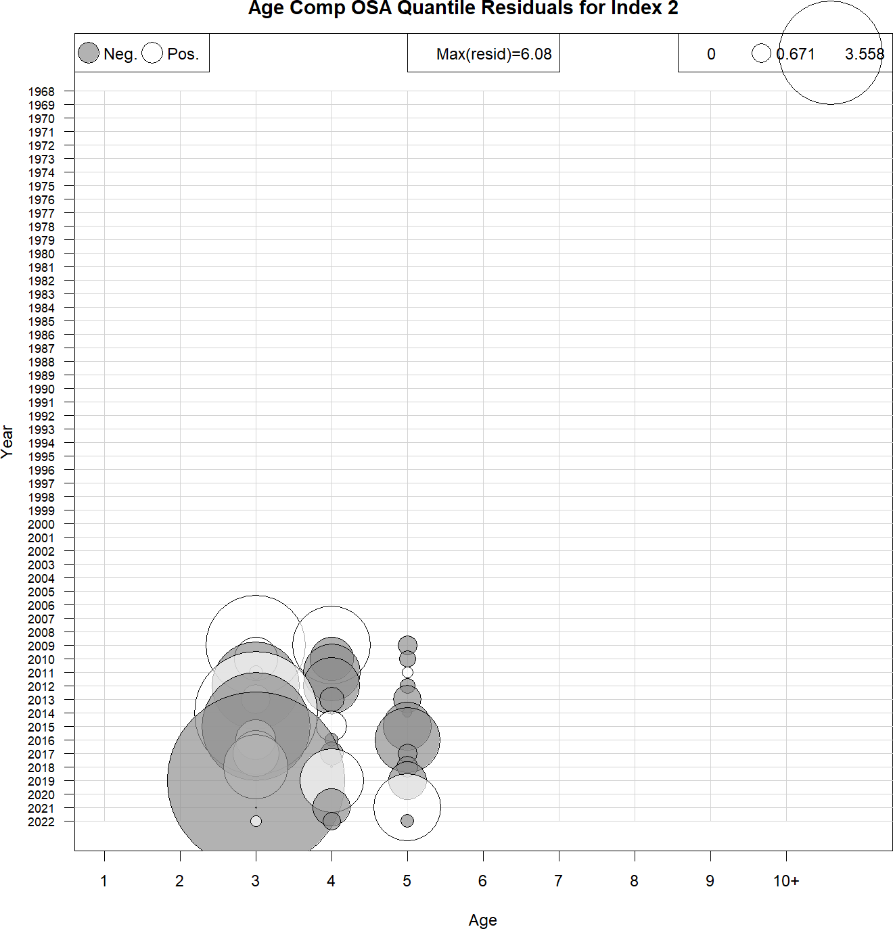
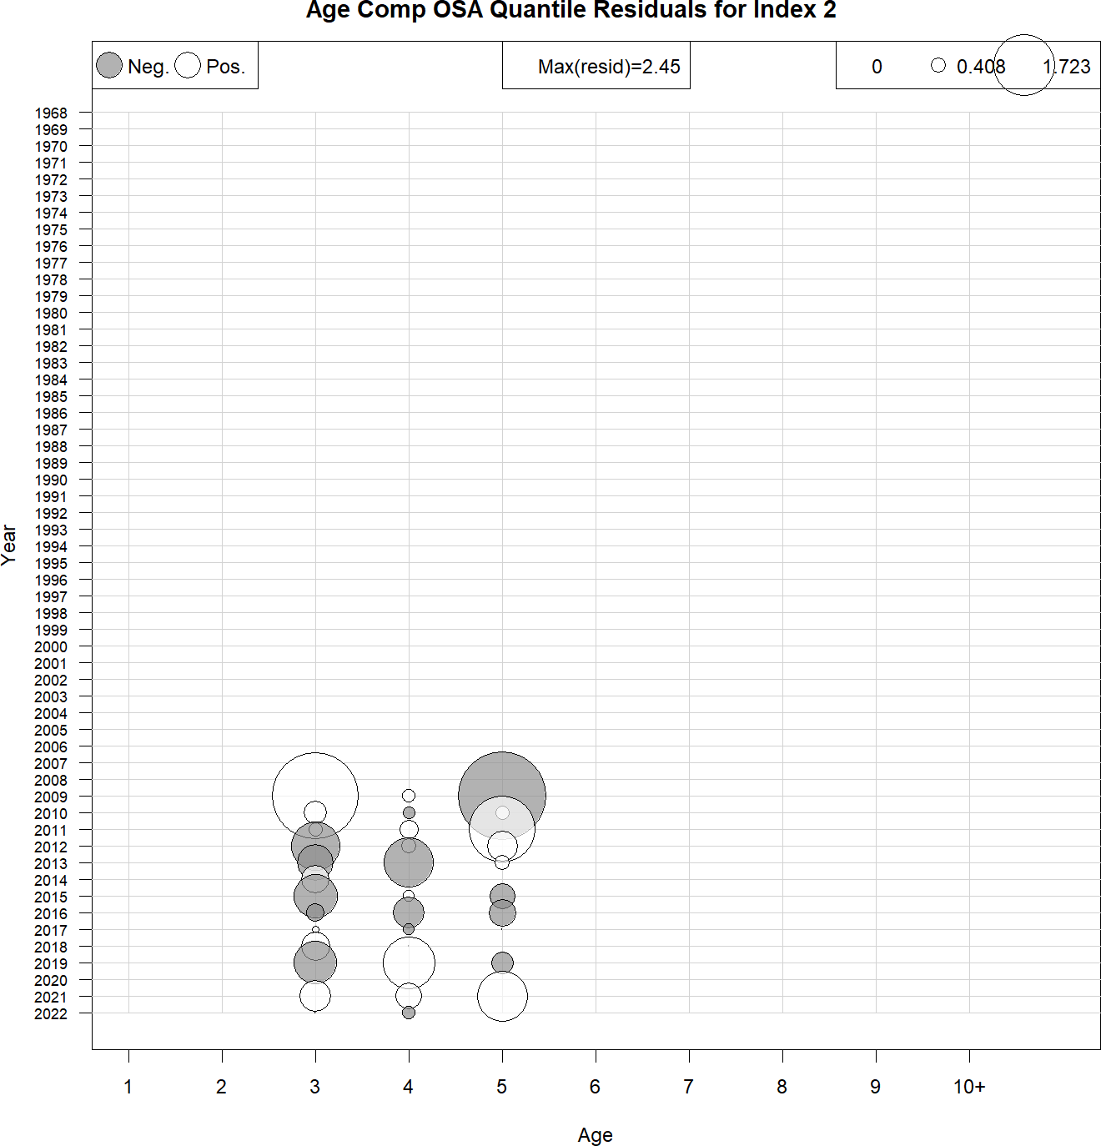
NEFSC Bigelow OSA residuals
Multinomial
Logistic-normal-ar1-miss0

Slide 17
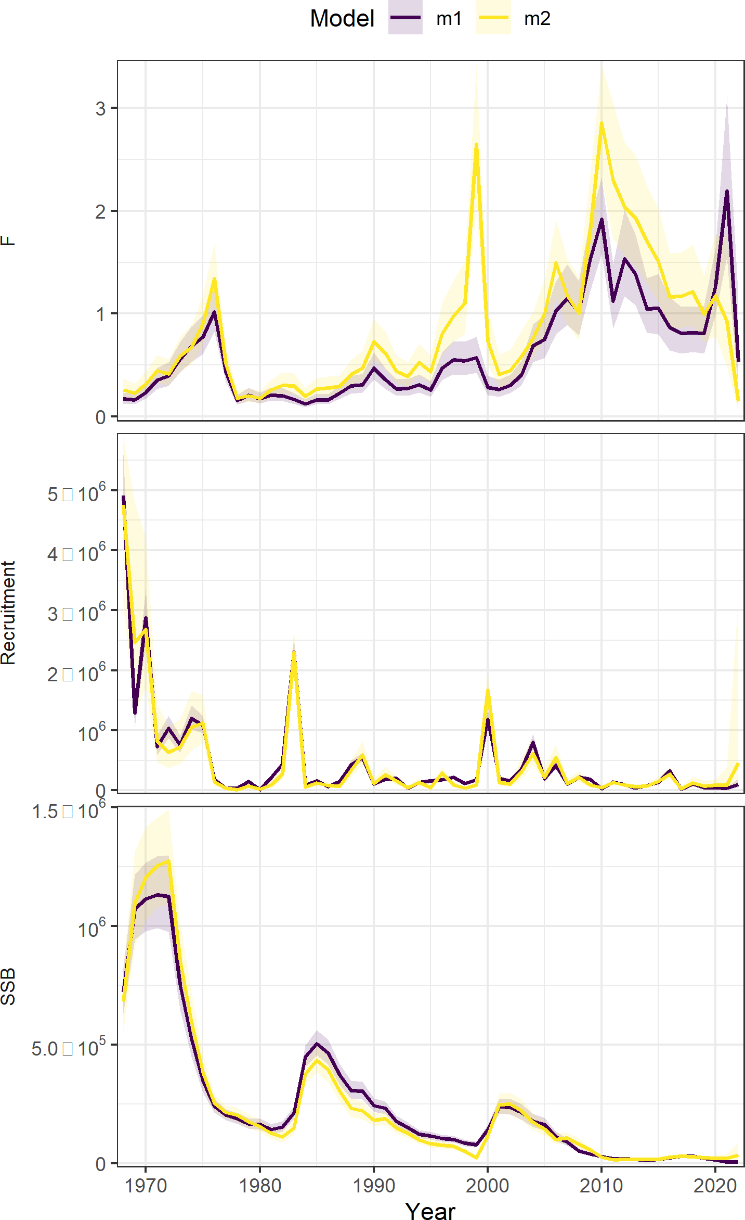
Age comp summary
Moved to logistic-normal
Run | age_comp | rho_R | rho_SSB | rho_Fbar
m1 | multinomial | 0.1608 | 0.3633 | -0.228
m2 | logistic-normal-ar1- miss0 | 0.8776 | 0.8802 | -0.4192
Figure 7 WP 10

Slide 18
The plan
ASAP → WHAM
Age-comps
Recruitment
Time varying
Selectivity
NAA

Slide 19
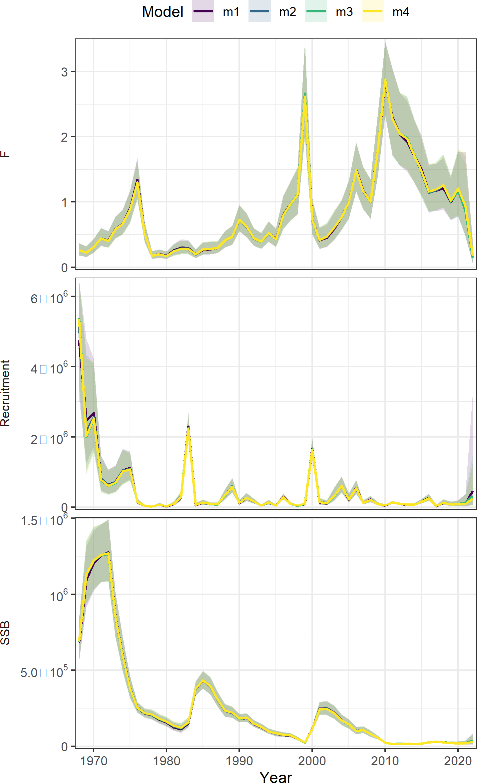
Recruitment
Runs | RE | dAIC | Rho R | Rho SSB | Rho Fbar | MASE egg | MASE Bigelow
m1 | None | 0 | 0.877 | 0.880 | -0.419 | 0.98 | 0.53
m2 | Ar1_y | 159.1 | 1.068 | 1.132 | -0.498 | 0.852 | 0.491
m3 | iid | 168.6 | 1.223 | 1.309 | -0.542 | 1.14 | 0.648
m4 | Beverton holt | 190.8 | 0.721 | 0.913 | -0.450 | 1.39 | 0.693
Table 2 WP 10
Figure 8 WP 10

Slide 20
The plan
ASAP → WHAM
Age-comps
Recruitment
Time varying
Selectivity
NAA

Slide 21
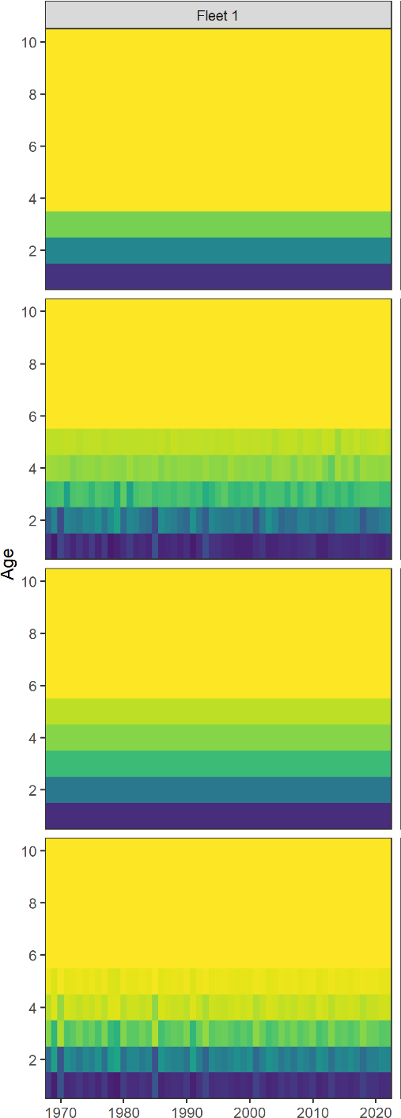
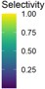
Time-varying selectivity
Runs | RE | dAIC | Rho R | Rho SSB | Rho Fbar | Mase egg | MASE Bigelow
m1 | None | 0 | 0.877 | 0.880 | -0.419 | 0.98 | 0.53
m4 | 2dar-1 | 327.6 | 0.820 | 0.928 | -0.3835 | 1.02 | 0.583
m2 | iid | 330.4 | 0.609 | 0.703 | -0.3622 | 0.964 | 0.562
m3 | ar1_y | 342.2 | 0.877 | 0.880 | -0.4192 | 0.955 | 0.556
Table 3 WP 10
Figure 10 WP 10

Slide 22
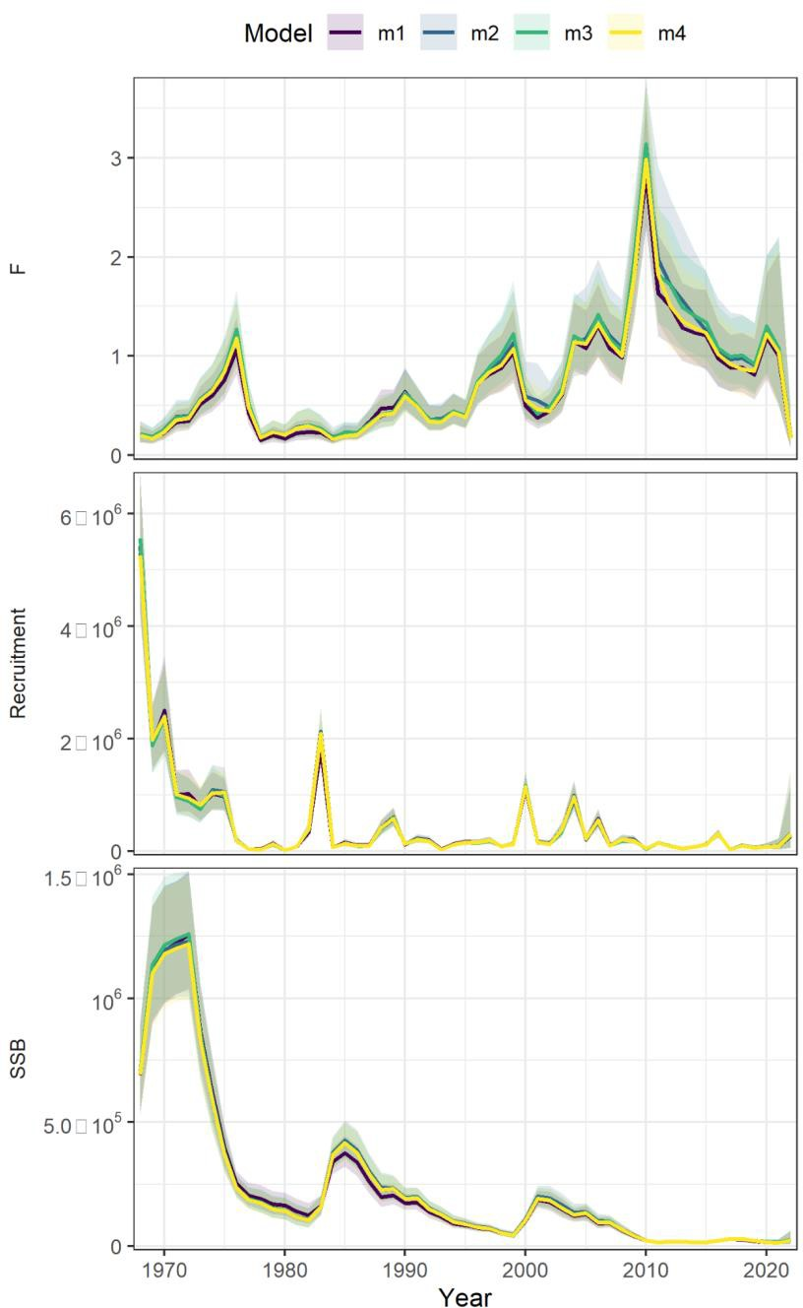
Time-varying selectivity
m1 = none m2 = IID
m3 = AR1_y m4 = 2DAR1
Figure 9 WP 10
21

Slide 23

The plan
ASAP → WHAM
Age-comps
Recruitment
Time varying
Selectivity
NAA

Slide 24
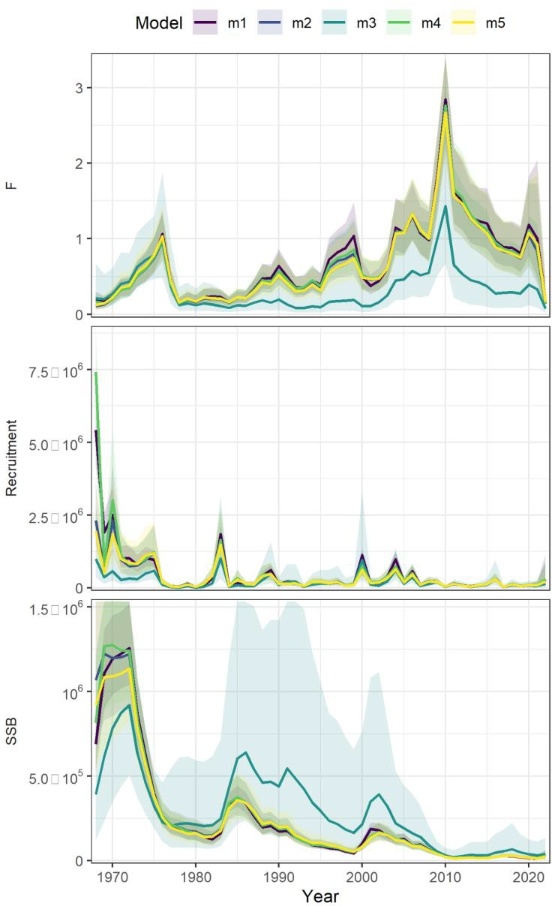
Random effects on NAA
Model | RE | dAIC | Rho R | Rho SSB | Rho Fbar | MASE egg | MASE Bigelow
m1 | none | 0 | 0.877 | 0.880 | -0.419 | 0.98 | 0.53
m4 | ar1_a | 152 | 1.090 | 1.231 | -0.535 | 0.91 | 0.47
m5 | ar1_y | 190.8 | 0.721 | 0.913 | -0.450 | 0.906 | 0.477
m2 | iid | 208.9 | 0.96 | 1.167 | -0.518 | 1.01 | 0.50
m3 | 2dar1 | 214.2 | 0.251 | 0.280 | -0.162 | 1.49 | 0.832
Table 3 WP 10
Figure 13 WP 10

Slide 25
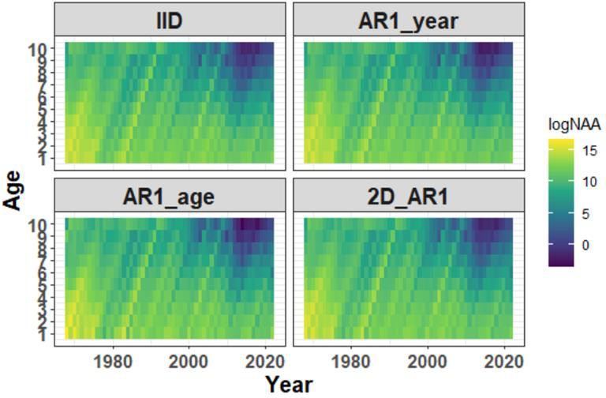
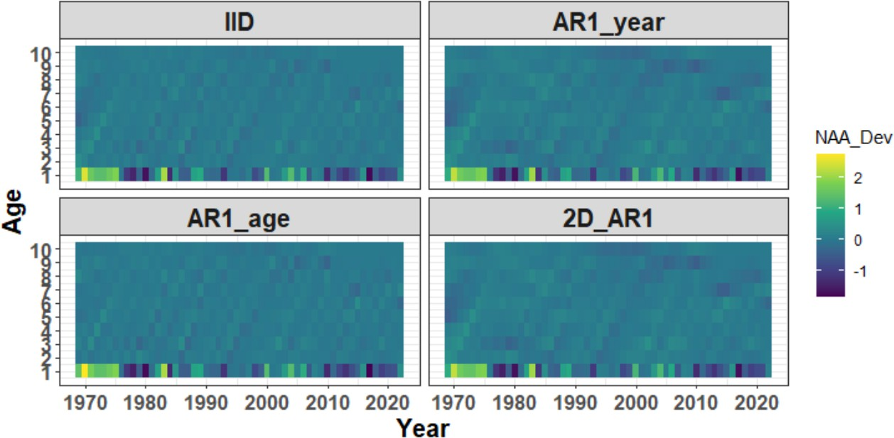
Random effects on NAA
Numbers at age
Deviations in numbers at age
Figure 11 WP 10
Figure 12 WP 10

Slide 26
Parameterization summary
Ages 1-10+
Fishery catch (1968-2022)
Surveys:
NEFSC spring (Albatross 1974-2008 ; ages 3+)
NEFSC spring (Bigelow 2009-2022; ages 3+)
Egg survey (1983-2022)
Natural mortality = 0.2
ASAP
Multinomial
Fixed effects only
WHAM
Logistic-normal-ar1-miss0
2dar1 on NAA

Slide 27
Selectivity
Block 1 = Fishery catch
Block 2 = Egg index Block 3 = Bigelow Block 4= Albatross

Slide 28
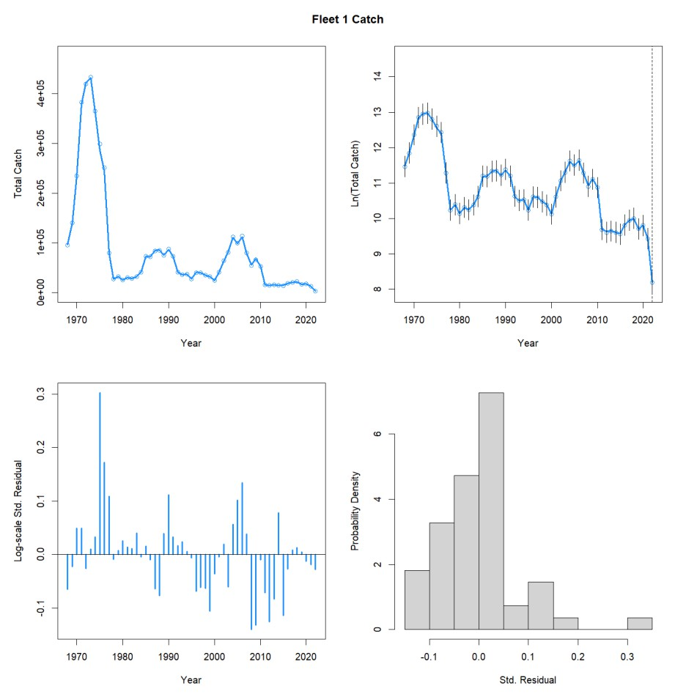
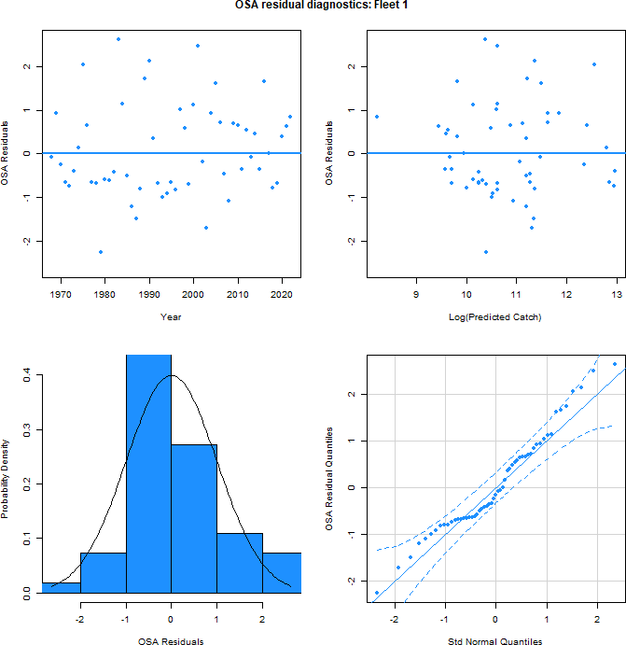
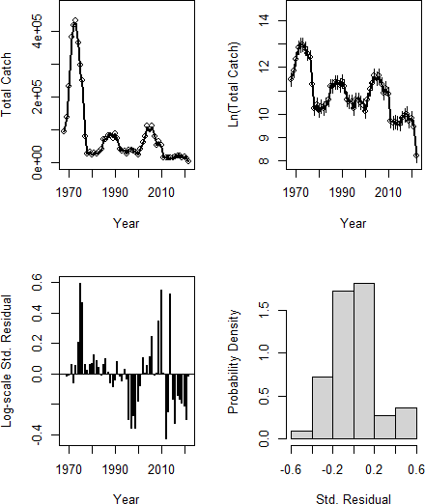
Catch aggregate fit
WHAM
ASAP
Figure 18 WP 10

Slide 29
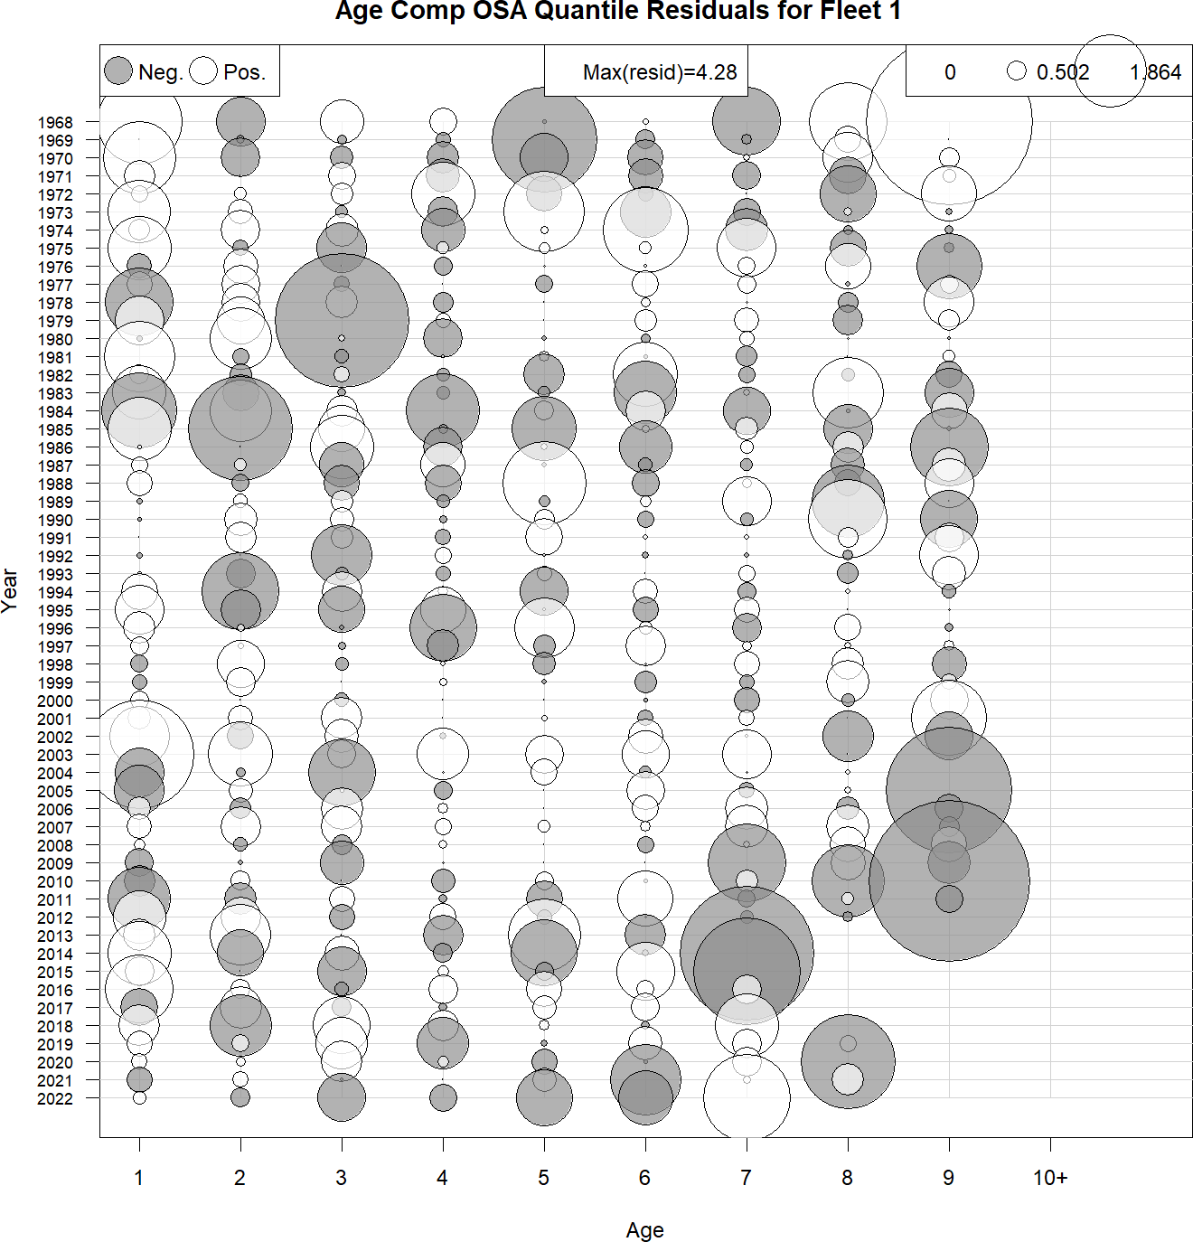
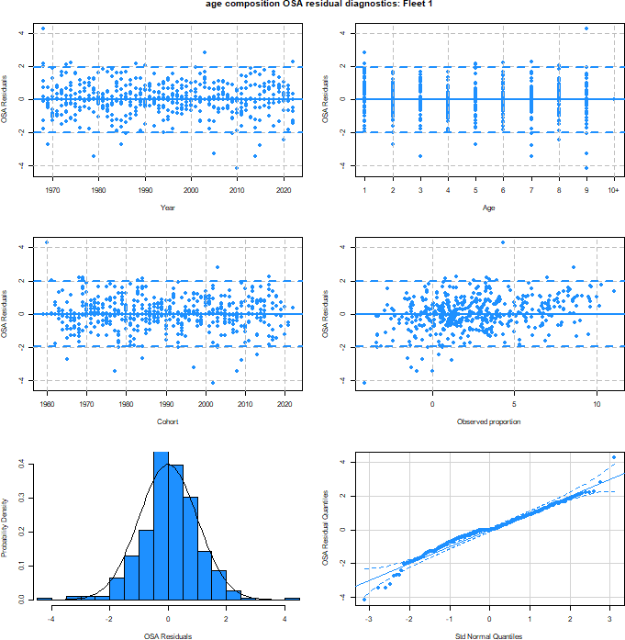
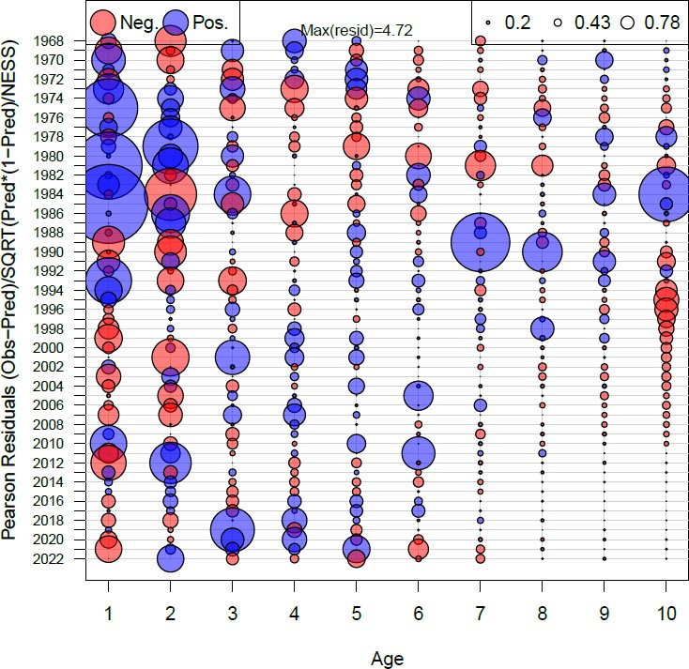
Catch age compositions
WHAM (OSA)
ASAP (Pearson)
Figure 18 WP 10

Slide 30
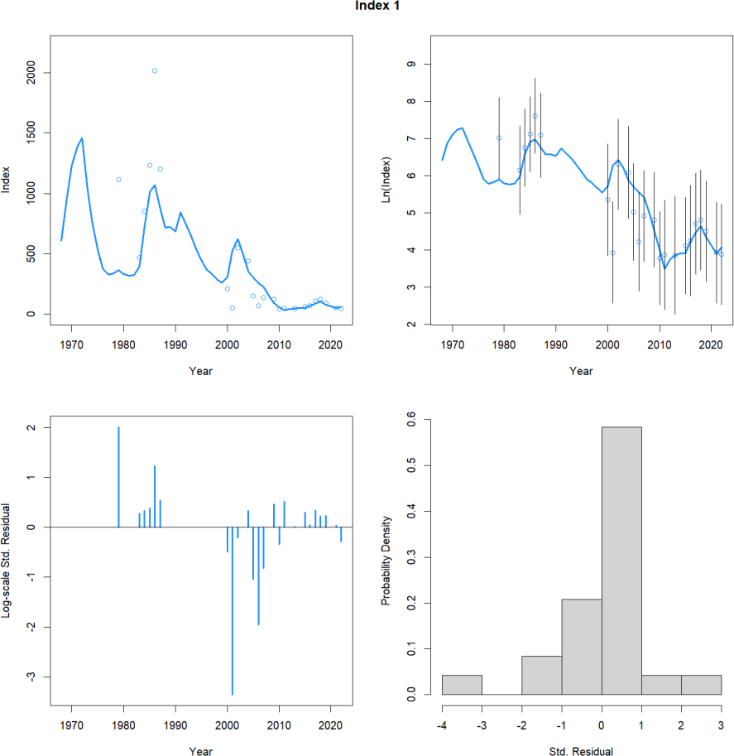
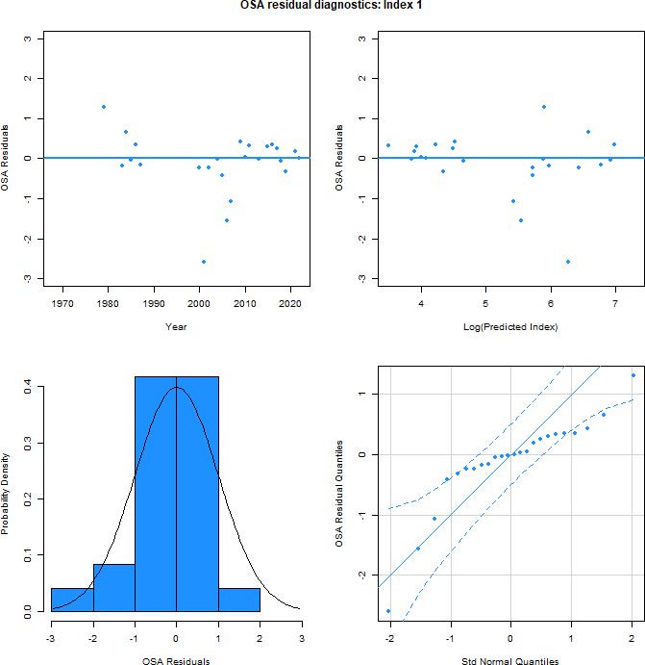
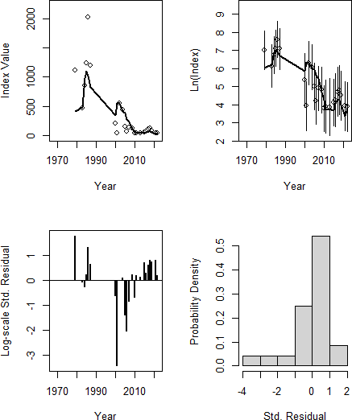
Egg survey aggregate fit
WHAM
ASAP
Figure 15 WP 10
29

Slide 31
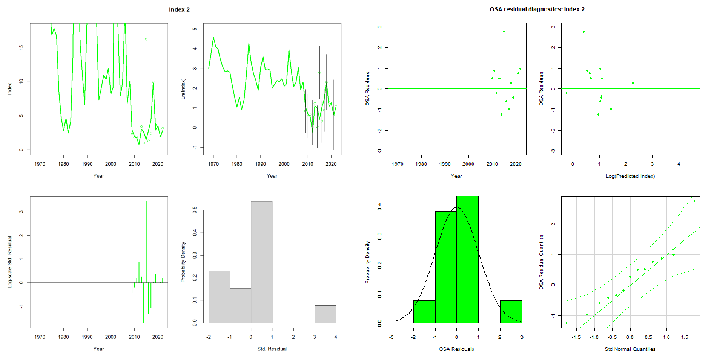
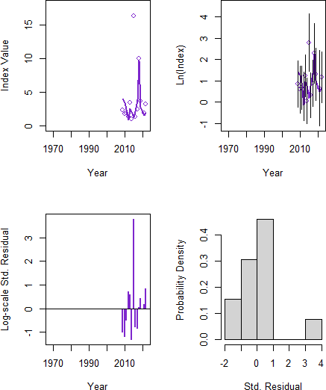
Bigelow survey aggregate fit
WHAM
ASAP
Figure 16 WP 10
30

Slide 32
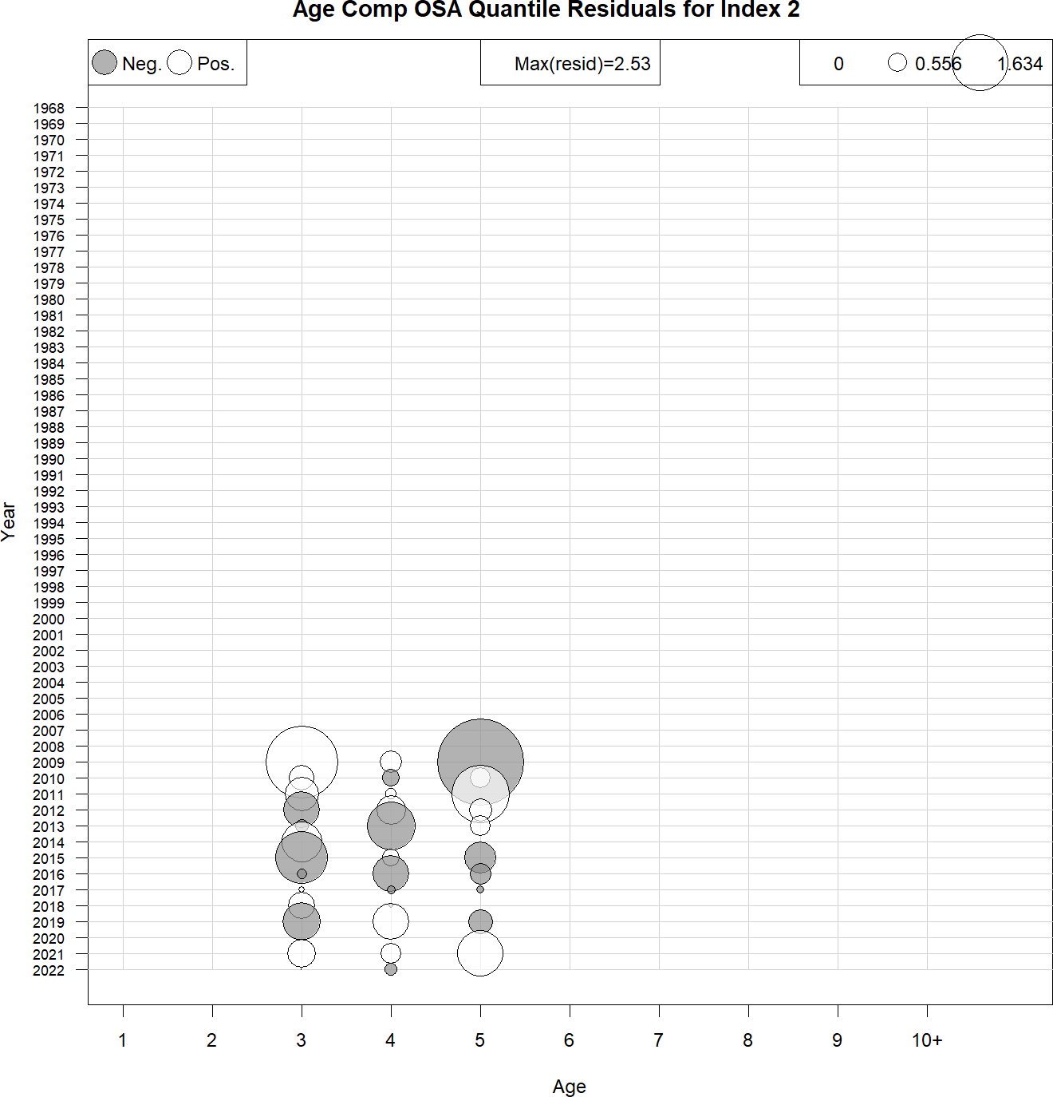
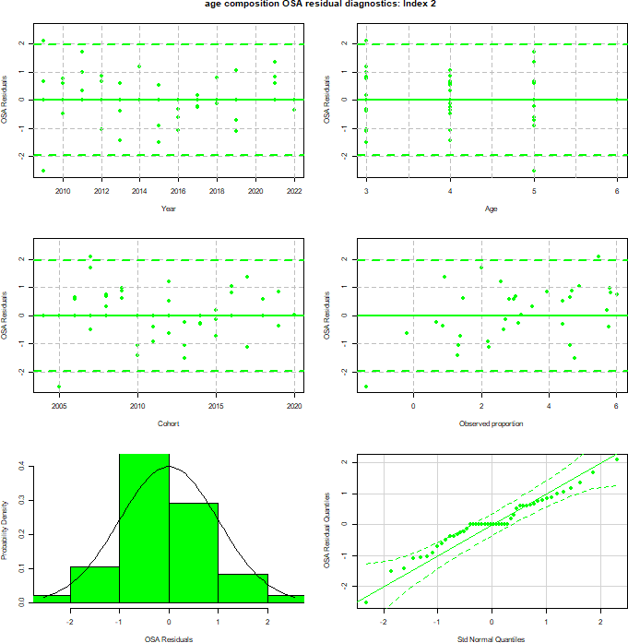
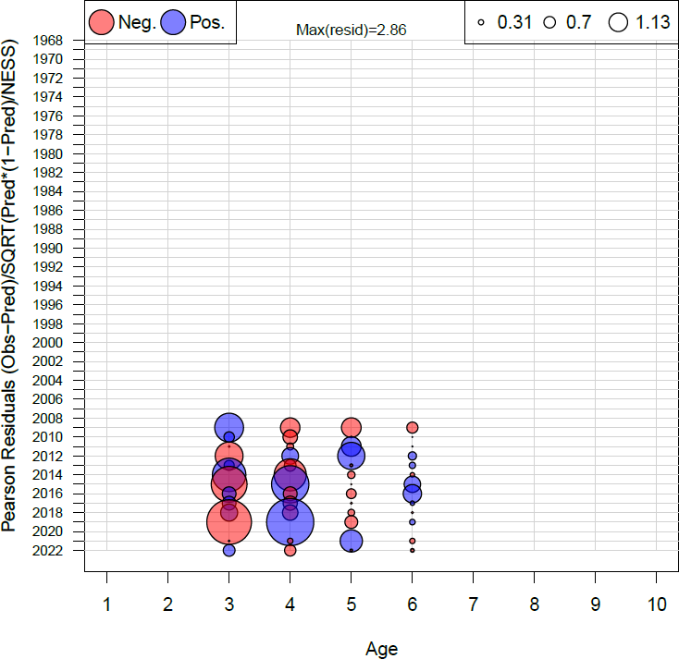
Bigelow age compositions
WHAM (OSA)
ASAP (Pearson)
Figure 20 WP 10
31

Slide 33
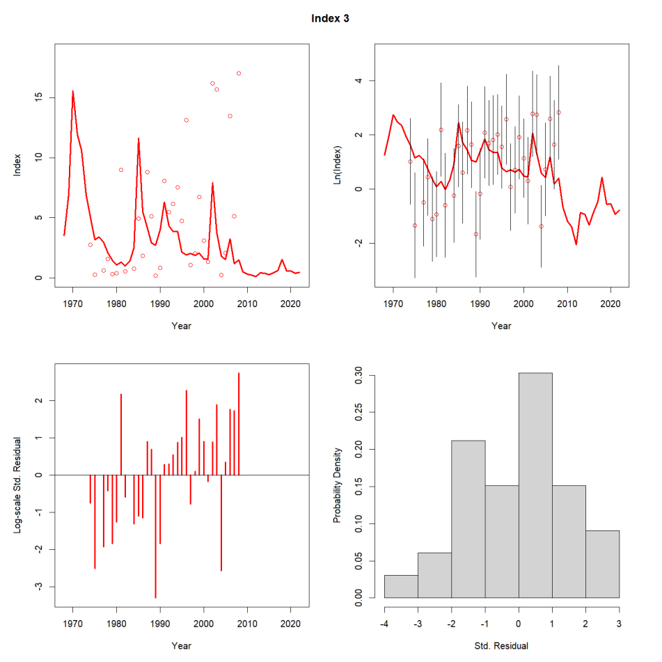
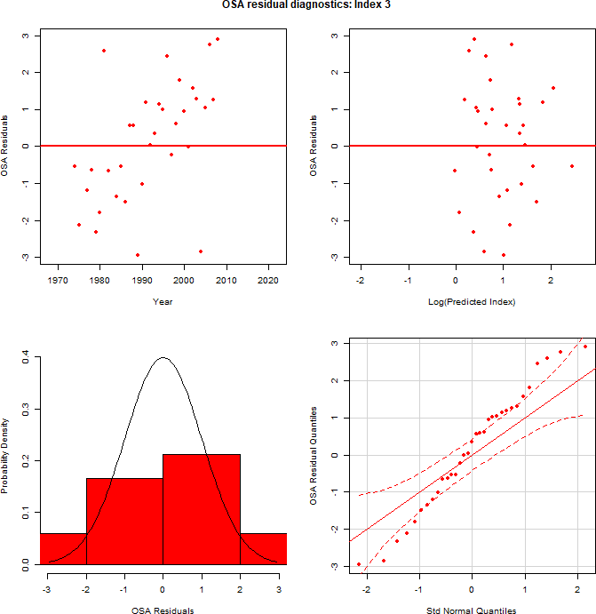
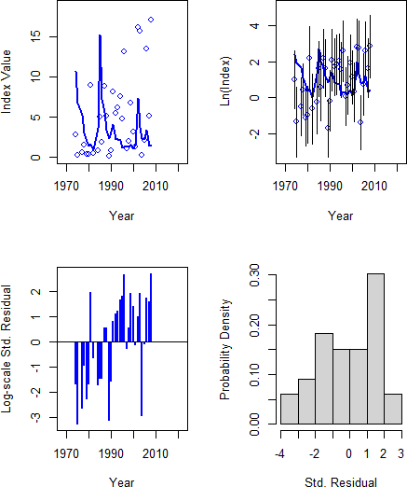
Albatross survey aggregate fit
WHAM
ASAP
Figure 17 WP 10
32

Slide 34
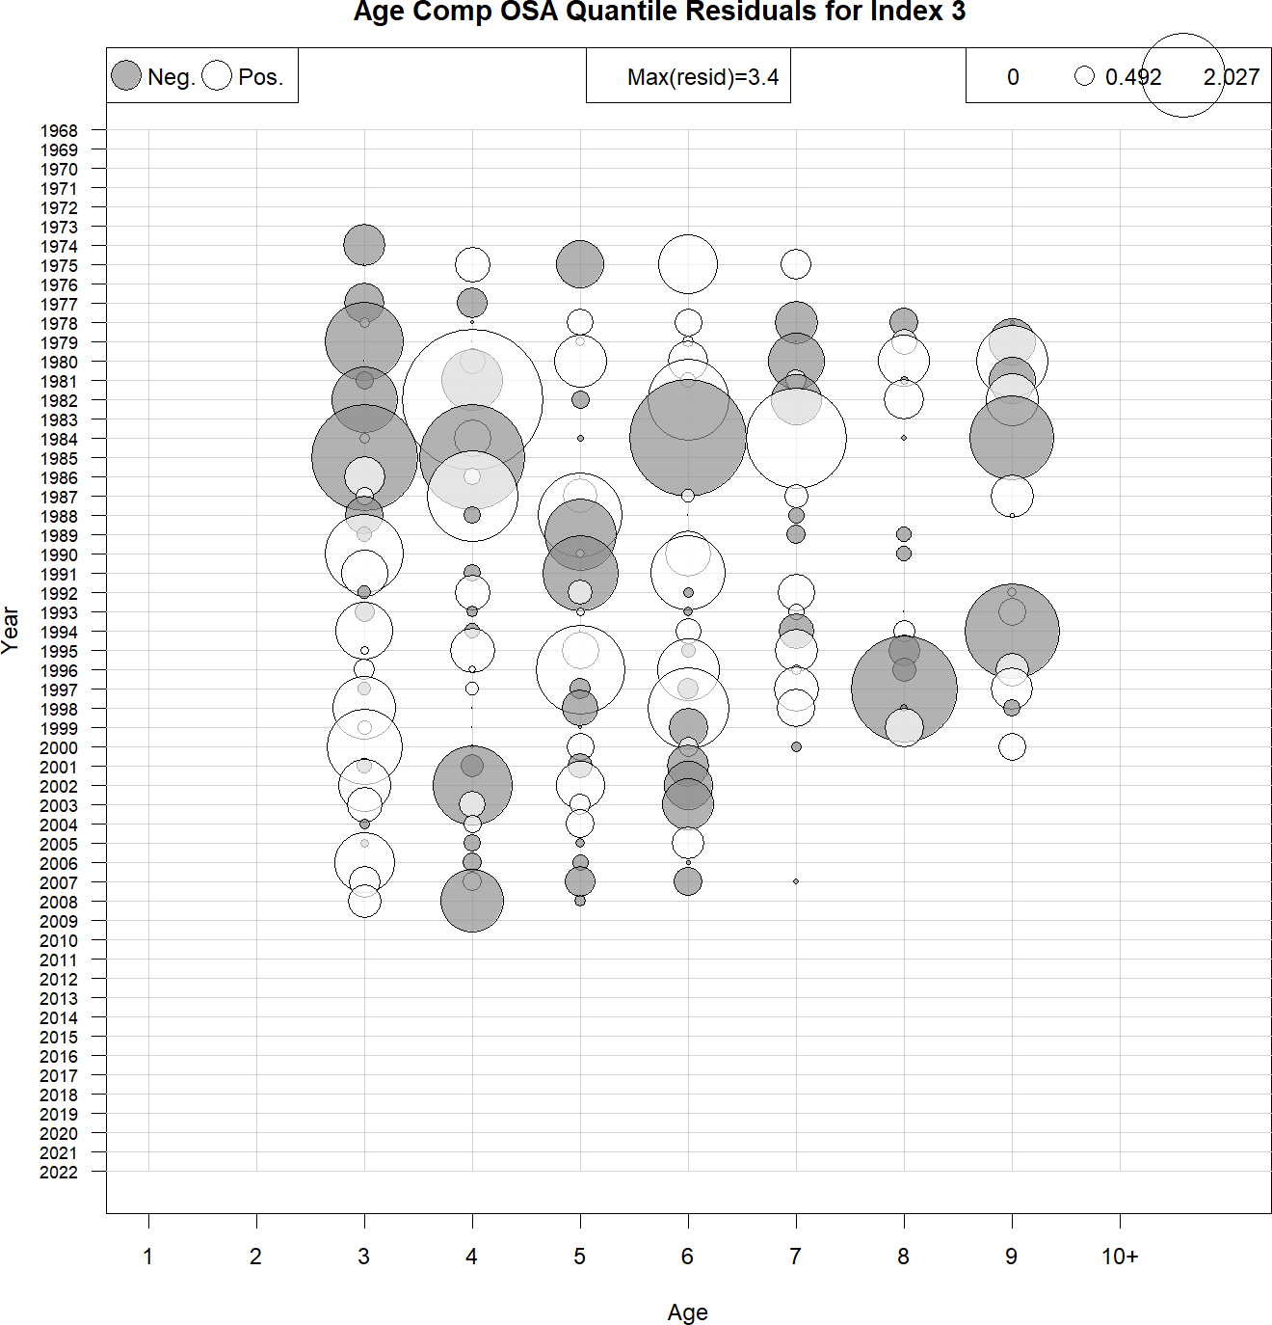
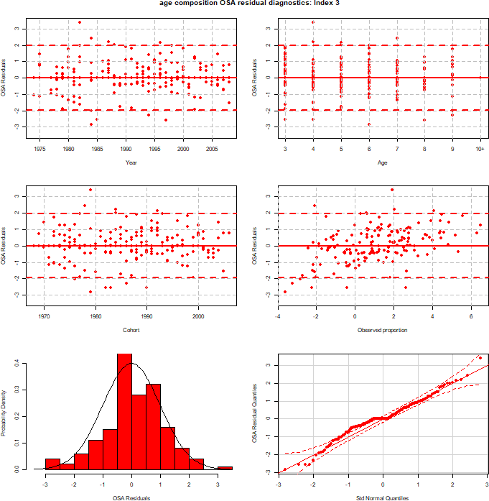
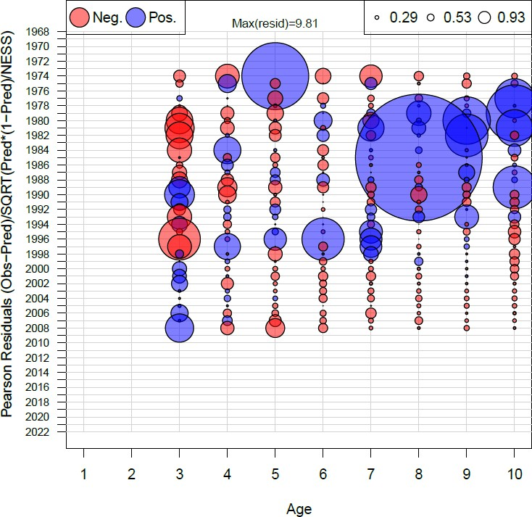
Albatross age compositions
WHAM (OSA)
ASAP (Pearson)
Figure 19 WP 10
33

Slide 35


Retro: SSB
ASAP
WHAM
ρ=0.281
Figure 21 WP 10

Slide 36


Retro: F
ASAP
WHAM
ρ= -0.162
Figure 21 WP 10

Slide 37

MASE
NEFSC Bigelow | Egg Survey
0.832 | 1.49
Table 5 WP 10
Figure 22 WP 10

Slide 38

Self-test
VAR | Mean Percent Bias
F | -0.71
R | 7.25
SSB | 5.67
Table 6 WP 10
Figure 23 WP 10

Slide 39
Diagnostic Summary
Similar fits to aggregate time series (though still strong patterning for Albatross time series)
Mohns rho
Good fits to age comps
Retros are better in WHAM
Poor prediction skill for the egg survey
Passes self-test
VAR | ASAP | WHAM
F | -0.306 | -0.162
SSB | 0.485 | 0.281
R | 0.132 | 0.251

Slide 40

ASAP to proposed WHAM model
ASAP
WHAM
Figure 25 WP 10
39

Slide 41
Future work
Exploration of high level of process error for numbers at age
Time varying survey catchability and fishery selectivity
(varying availability to NEFSC trawl survey and contributions of US and Canadian fisheries to total fishery catch)
Time-varying natural mortality
Recruitment
40

Slide 42

Biological reference points
M1 = ASAP M2 = WHAM
 | ASAP | WHAM
F40% | 0.21 | 0.16
SSB40% | 154,107 (86,490 – 332,677) | 128,150 (49,587-331,184)
Yield40% | 30,460 (17,321 – 63,448) | 23,724 (9,123 – 61,693)
Table 7 WP 10
41
Figure 24 WP 10

Slide 43

Short-term projections
Year | Parameter | WHAM | ASAP
2023 | SSB | 56,696 (14,159-227,025) | 43,721 (17,764-100,647)
2024 | SSB | 79,974 (12,770-500,858) | 67,524 (32,341-143,307)
2025 | SSB | 87,139 (7,424-1,022,820) | 77,038 (43,184-156,933)
2026 | SSB | 83,319 (3,395-2,044,805) | 81,551 (47,719-176,672)
2023 | F | 0.08 (0.02-0.37) | 0.15 (0.07-0.34)
2024 | F | 0.16 (0.15-0.18) | 0.21 (0.21-0.21)
2025 | F | 0.16 (0.15-0.18) | 0.21 (0.21-0.21)
2026 | F | 0.16 (0.15-0.18) | 0.21 (0.21-0.21)
2023 | Catch | 5,953 (5,953-5,953) | 5,953 (5,953-5,953)
2024 | Catch | 15,429 (2,162-110,092) | 12,618 (6,127-27,331)
2025 | Catch | 16,285 (1,234-214,936) | 14,671 (8,301-30,242)
2026 | Catch | 15,422 (571-416,762) | 15,694 (9,268-33,414)
2023 | Rect | 131,200 (7,204-2,389,543) | 91,342 (28,584-294,287)
2024 | Rect | 115,979 (2,853-4,714,488) | 107,496 (29,362-405,817)
2025 | Rect | 102,721 (1,329-7,940,735) | 111,252 (29,651-470,921)
2026 | Rect | 91,150 (683-12,168,829) | 116,499 (29,937-524,124)
Figure 26 WP 10
Table 8 WP 10

Slide 44
Summary
Takeaways
WHAM run:
logistic-normal-ar1-miss0 for fleet and surveys
2dar1 on NAA
WHAM had decent diagnostics
WHAM had improved retros
Fixed effects WHAM replicates ASAP
Research recommendations
Exploration of high level of process error for numbers at age
Time varying survey catchability and selectivity
Time varying natural mortality
Recruitment
Projection uncertainty

Slide 45
Back pocket slides

Slide 46
Asap-like WHAM run (fixed effects only)

Slide 47


Fishery catch: aggregate
WHAM
ASAP

Slide 48


Fishery catch: age compositions
WHAM
ASAP

Slide 49


Egg index
WHAM
ASAP

Slide 50


Albatross: aggregate
WHAM
ASAP

Slide 51


Albatross: age compositions
WHAM
ASAP

Slide 52


Bigelow: aggregate
WHAM
ASAP

Slide 53


Bigelow: age compositions
WHAM
ASAP

Slide 54



Retrospective
WHAM
ASAP
SSB
F
ρ= -0.306
ρ=0.485
ρ=0.281
ρ= -0.162

Slide 55


Historical retrospective
* 2009 TRAC did not pass peer review

Slide 56
Historical retrospective (2)
Diagnostic issues with both assessments prior to 2017
2009 TRAC did not pass peer review
2009: ‘05 model should not be used for management
Notes:
C:\Users\kiersten.curti\Desktop\Benchmark.2017\First.Year.1968\Run118.final.model.comparisons\Historical.retrospective.wmf

